Slide 1

Chapter 16
Input Design and Prototyping
Notes:
This repository of slides is intended to support the named chapter. The slide repository should be used as follows:
Copy the file to a unique name for your course and unit.
Edit the file by deleting those slides you don’t want to cover, editing other slides as appropriate to your course, and adding slides as desired.
Print the slides to produce transparency masters or print directly to film or present the slides using a computer image projector.
Each slide includes instructor notes. To view those notes in PowerPoint, click-left on the View Menu; then click left on Notes View sub-menu. You may need to scroll down to see the instructor notes.
The instructor notes are also available in hardcopy as the Instructor Guide to Accompany Systems Analysis and Design Methods, 6/ed.

Slide 2
Objectives
Define the appropriate format and media for a computer input.
Explain the difference between data capture, data entry, and data input.
Identify and describe several automatic data collection technologies.
Apply human factors to the design of computer inputs.
Design internal controls for computer inputs.
Select proper screen-based controls for input attributes that are to appear on a GUI input screen.
Design a web-based input interface.
Notes:
No additional notes.

Slide 3
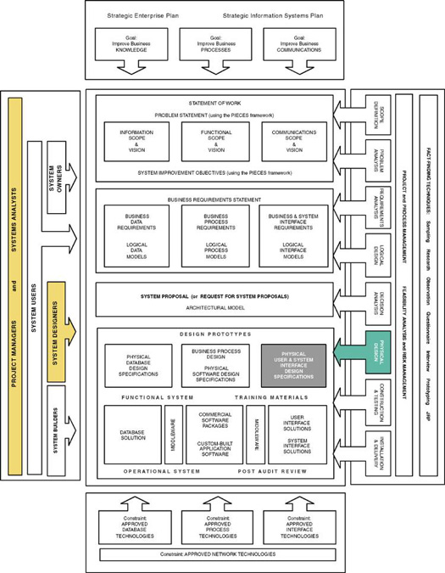
Notes:
Chapter 16 – Input Design and Prototyping
Teaching Notes
This slide shows the how this chapter's content fits with the building blocks framework used throughout the textbook. The emphasis of this chapter is with the physical design phase, focusing on the communication building blocks. It involves system designers and systems analysts.

Slide 4
Data Capture and Data Entry
Data capture – the identification and acquisition of new data (at its source).
  Source documents – forms used to record business transactions in terms of data that describe those transactions.
Data entry – the process of translating the source data or document (above) into a computer readable format.
Notes:
No additional notes.

Slide 5
Data Processing
Data processing is all processing that occurs on the data after it is input from a machine readable form.
  In batch processing, the entered data is collected into files called batches and processed as a complete batch.
  In on-line processing, the captured data is processed immediately
  In remote batch processing, data is entered and edited on-line, but collected into batches for subsequent processing.
Notes:
No additional notes.

Slide 6
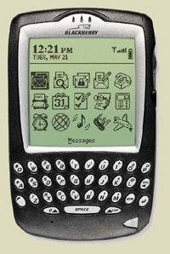
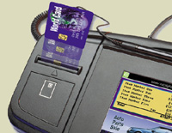
Input Implementation Methods
Keyboard
Mouse
Touch Screen
Point-of-sale terminals
Sound and speech
Automatic data capture
  Optical mark recognition (OMR)
    Bar codes
  Optical character recognition (OCR)
  Magnetic Ink
  Electromagnetic transmission
  Smart cards
  Biometric
Notes:
Teaching Notes
We tend to think of input solely in terms of keyboard and mouse on a PC. But as this slide points out, there are many kinds of input and many kinds of input terminals (i.e. the Blackberry device shown here).

Slide 7
Taxonomy for Computer Inputs
Process Method | Data Capture | Data Entry | Data Processing
Keyboard | Data is usually captured on a business form that becomes the source document for input. Data can be collected real-time. | Data is entered via keyboard. This is the most common input method but also the most prone to errors. | OLD: Data can be collected into batch files (disk) for processing as a batch. NEW: Data is processed as soon as it has been keyed.
Mouse | Same as above. | Used in conjunction with keyboard to simplify data entry. Mouse serves as a pointing device for a screen. | Same as above, but the use of a mouse is most commonly associated with online and real-time processing.
Touch Screen | Same as above. | Data is entered o a touch screen display or handheld device. Data entry users either touch commands and data choices or enter data using handwriting recognition. | On PCs, touch screen choices are processed same as above. On handheld computers, data is sorted on the handheld for later processing as a remote batch.
Notes:
Teaching Notes
The categories are not necessarily mutually exclusive.

Slide 8
Taxonomy for Computer Inputs (continued)
Process Method | Data Capture | Data Entry | Data Processing
Point of Sale | Data captured as close to the point of sale as humanly possible. No source documents. | Data is often entered directly by the customer or by an employee directly interacting with the customer. | Data is almost always processed immediately as a transaction or inquiry.
Sound | Data is captured as close to the source as possible, even when the customer is remotely located. | Data is entered using touch-tones (typically from a telephone). Usually requires rigid command menu structure and limited input options. | Data is almost always processed immediately as a transaction or inquiry.
Speech | Same as sound. | Data (and commands) is spoken. This technology is not as mature and is much less reliable and common than other techniques. | Data is almost always processed immediately as a transaction or inquiry.
Optical Mark | Data is recorded on optical scan sheets as marks or precisely formed letter, numbers, and punctuation. | Eliminates the need for data entry. | Data is almost always processed as a batch.
Notes:
Teaching Notes
The categories are not necessarily mutually exclusive.

Slide 9
Taxonomy for Computer Inputs (concluded)
Process Method | Data Capture | Data Entry | Data Processing
Magnetic Ink | Data usually prerecorded on forms that are completed by the customer. The customer records additional information on the form. | A magnetic ink reader reads the magnetized data. The customer-added data must be entered using another input method. | Data is almost always processed as a batch.
Electromagnetic | Data is recorded directly on the object to be described by data. | Data is transmitted by radio frequency. | Data is almost always processed immediately.
Smart Card | Data is recorded directly on a device to be carried by the customer, employee, or other individual that is described by that data. | Data is read by smart card readers. | Data is almost always processed immediately.
Biometric | Unique human characteristics become data | Data read by biometric sensors. Primary applications are security and medical monitoring | Data is processed immediately.
Notes:
Teaching Notes
The categories are not necessarily mutually exclusive.

Slide 10
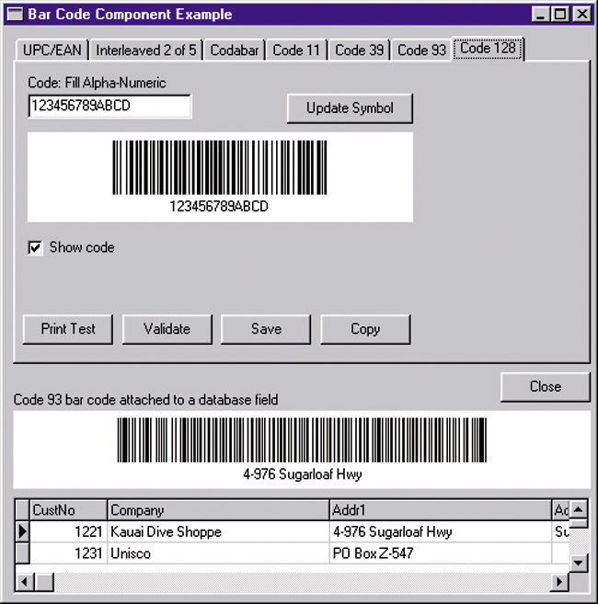
Automatic Identification:
Bar Codes
Notes:
Teaching Notes
This screen shot shows two different bar codes, each with the data equivalent shown below. Point out that bar codes can represent letters as well as numbers. In other words, you name could be represented by a bar code.
This screen shot mentions "Code 93." This is one of several different symbologies that bar codes can support.
Reading a bar code is a simple as attaching a bar code devices to a computer and setting it for the correct symbology. When a bar code is scanned, the alphanumeric value is entered to the computer just as if a user typed that value on the keyboard.
Printing bar codes is more complex, requiring special software.

Slide 11
Input Design Guidelines
Capture only variable data.
  Not data that can be looked up.
Do not capture data that can calculated or stored in computer programs as constants.
  Extended Price, Federal Withholding, etc.
Use codes for appropriate attributes.
Notes:
No additional notes.

Slide 12
Source Document /
Form Design Guidelines
Include instructions for completing the form.
Minimize the amount of handwriting.
Data to be entered (keyed) should be sequenced top-to-bottom and left-to-right.
When possible use designs based on known metaphors.
Notes:
No additional notes.

Slide 13
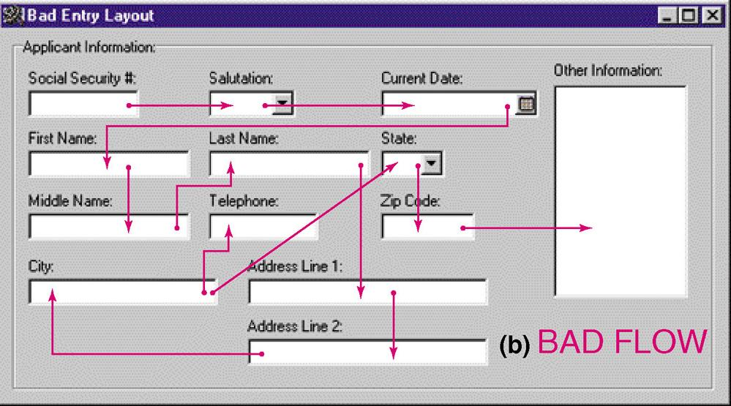
Bad Flow in a Form
Notes:
Teaching Notes
Experienced users often tab around a form. The tab order should be set correctly.

Slide 14
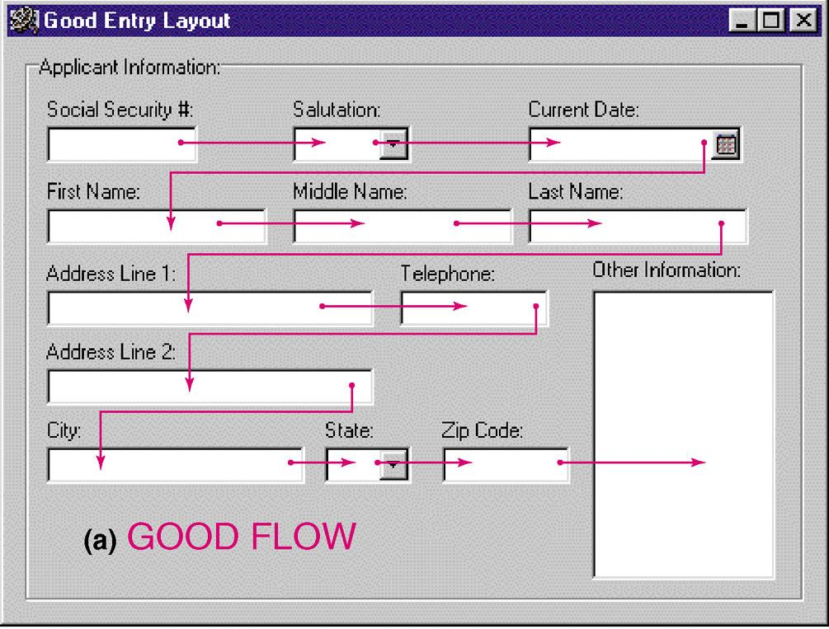
Good Flow in a Form
Notes:
No additional notes.

Slide 15
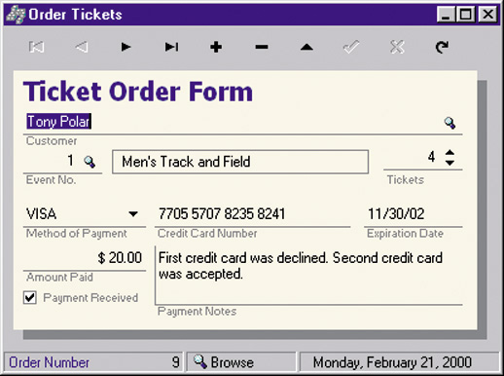
Metaphoric Screen Design
Notes:
Teaching Notes
Other useful metaphors include a check, a register, and a calendar.
Pictures of objects can also be metaphors. For example, many Web sites use a picture of each credit card accepted instead of the names.

Slide 16
Internal Controls for Inputs
The number of inputs should be monitored (to minimize risk of lost transactions).
  For batch processing
    Use batch control slips
    Use one-for-one checks against post-processing detail reports
  For on-line systems
    Log each transaction as it occurs to a separate audit file
Validate all data
  Existence checks
  Data-type checks
  Domain checks
  Combination checks
  Self-checking digits
  Format checks
Notes:
No additional notes.

Slide 17
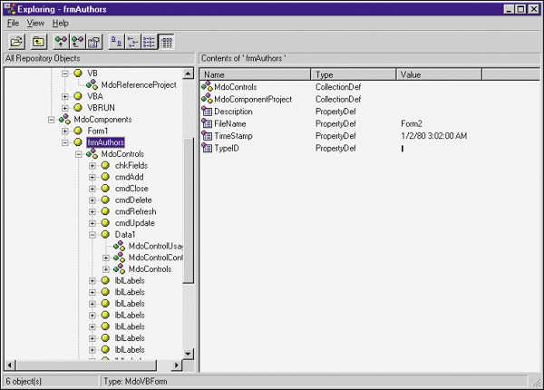
Repository-Based Prototyping and Development
Define properties and constraints for a reusable field
Notes:
No additional notes.

Slide 18
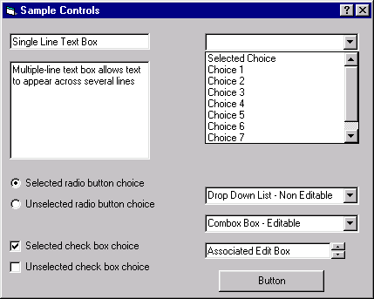
Common GUI Controls (Windows and Web)
Text boxes
Radio buttons
Check boxes
List boxes
Drop down lists
Combination boxes
Spin boxes
Buttons
Notes:
No additional notes:

Slide 19
Common GUI Controls Uses
Text boxes
  When the input data values are unlimited in scope
Radio buttons
  When data has limited predefined set of mutually exclusive values
Check boxes
  When value set consists of a simple yes or no value
List boxes
  When data has a large number of possible values
Drop down lists
  When data has large number of possible values and screen space is too limited for a list box
Combination boxes
  To provide user with option of selecting value from a list or typing a value that may or may not appear in the list
Spin boxes
  When need to navigate through a small set of choices or directly typing a data value
Notes:
Teaching Notes
It would be helpful to also go over the guidelines discussed in the text for each.

Slide 20
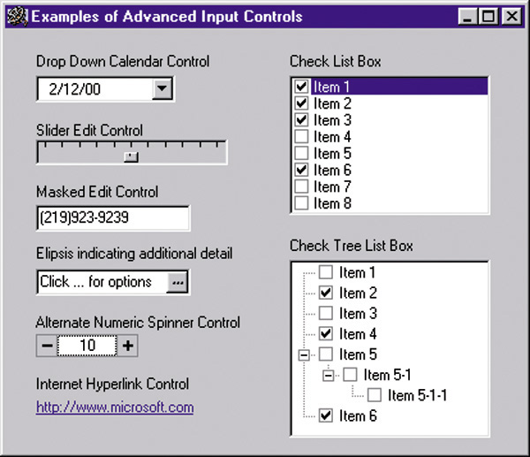
Advanced Controls
(mostly Windows interfaces)
Drop down calendars
Slider edit controls
Masked edit controls
Ellipsis controls
Alternate numerical spinners
Check list boxes
Check tree boxes
Notes:
No additional notes:

Slide 21
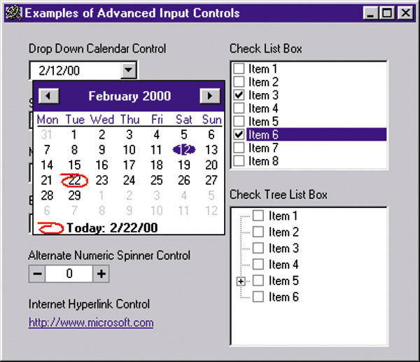
Advanced Controls
(mostly Windows interfaces)
Notes:
No additional notes:

Slide 22
Automated Tools for Input Design and Prototyping
Old Tools
  Record Layout Charts
  Display Layout Charts
Newer Prototyping Tools
  Microsoft Access
  CASE Tools
  Visual Basic
  Excel
  Visio
Notes:
No additional notes:

Slide 23
Input Design Process
Identify system inputs and review logical requirements.
Select appropriate GUI controls.
Design, validate and test inputs using some combination of:
  Layout tools (e.g., hand sketches, spacing charts, or CASE tools.
  Prototyping tools (e.g., spreadsheet, PC DBMS, 4GL)
As necessary design source documents.
Notes:
No additional notes.

Slide 24
A Logical Data Structure for Input Requirements
ORDER = ORDER NUMBER
+ ORDER DATE
+ CUSTOMER NUMBER
+ CUSTOMER NAME
+ CUSTOMER SHIPPING ADDRESS = ADDRESS >
+ ( CUSTOMER BILLING ADDRESS = ADDRESS > )
+ 1 { PRODUCT NUMBER +
QUANTITY ORDERED } n
+ ( DEFAULT CREDIT CARD NUMBER )
ADDRESS = ( POST OFFICE BOX NUMBER )
+ STREET ADDRESS
+ CITY
+ STATE
+ POSTAL ZONE
Notes:
Teaching Notes
It may be useful to walk through this technique for specifying “logical” output requirements.
The red and blue symbols are relational operators, that is, they specify the relationship between attributes to be included in the output in terms of
Sequence +
Selection [ data attributes]
Iteration min { data attributes } max
Optionality ( data attributes)
Many CASE tools support this logical notation.

Slide 25
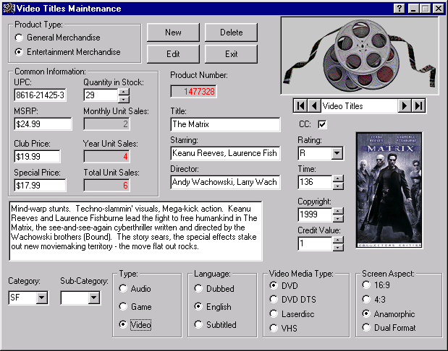
Input Prototype for Video Title Maintenance
Notes:
No additional notes.

Slide 26
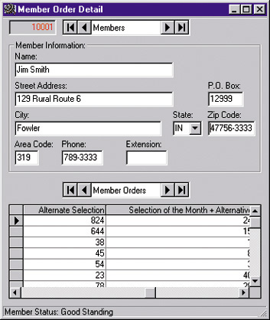
Input Prototype for Member Order
Notes:
No additional notes.

Slide 27
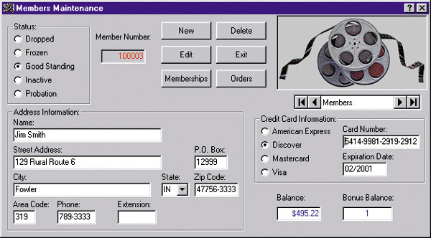
Input Prototype for Member Shopping
Notes:
No additional notes.

Slide 28
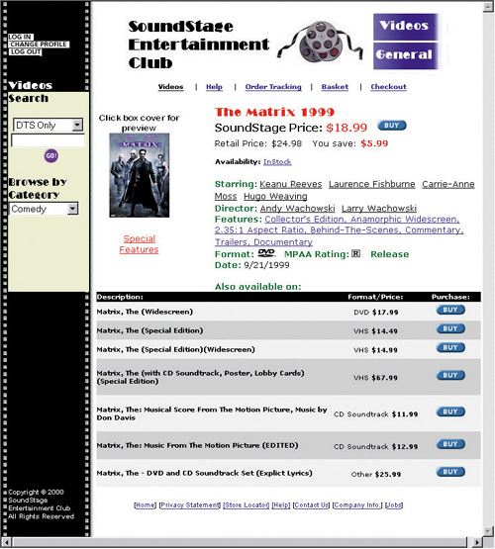
Input Prototype for Web Shopping Cart
Notes:
No additional notes.

Slide 29
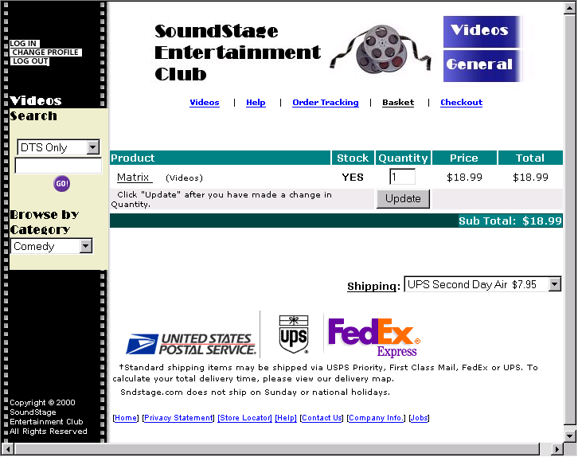
Input Prototype for Web Interface
Notes:
No additional notes.

